Slide 1


DECK FOR QUALIFIED TEAMS OF BHASHINI-SPRINT GRAND FINALE

Slide 2


Slide 1: Introduction and Problem Statement name with description
Title: Mention the solution name/team name/company name
Team Leader Name :
Team Members/mentors name :
Phone number & Email Id of Team leader and team members
Content
Briefly introduce the project and its purpose
Explain the challenges during of the particular problem statement

Slide 3

Slide 2: Solution Architecture
Content
1.High-level architecture diagram
Show components
Describe data flow
2.Explain how the engine works in real time
3.Mention any third-party APIs or services used

Slide 4

Slide 3: Technology Stack
Title: “Tech Stack”
Content
1.List the technologies and tools used
NLP libraries
Backend framework
Frontend technologies
Cloud services
2.Briefly explain why each technology was chosen

Slide 5
Slide 4: Code Snippets and Workflow
Title: “Code and Functionality”
Content
1.Showcase relevant code snippets
Example of tech functionality
How context-aware suggestions are generated
Interaction with the various platform
2.Describe the overall workflow

Slide 6

Slide 5: Financial & Technical requirements
Title: “Financial & Technical requirements”
Content
1.Discuss the cost involved/required for developing the solution
2.Mention all the parameters
Cloud requirement
Model training required if any
Cost and Number of developers required for maintaining the solution platform and operations
Any other requirement which involves cost

Slide 7
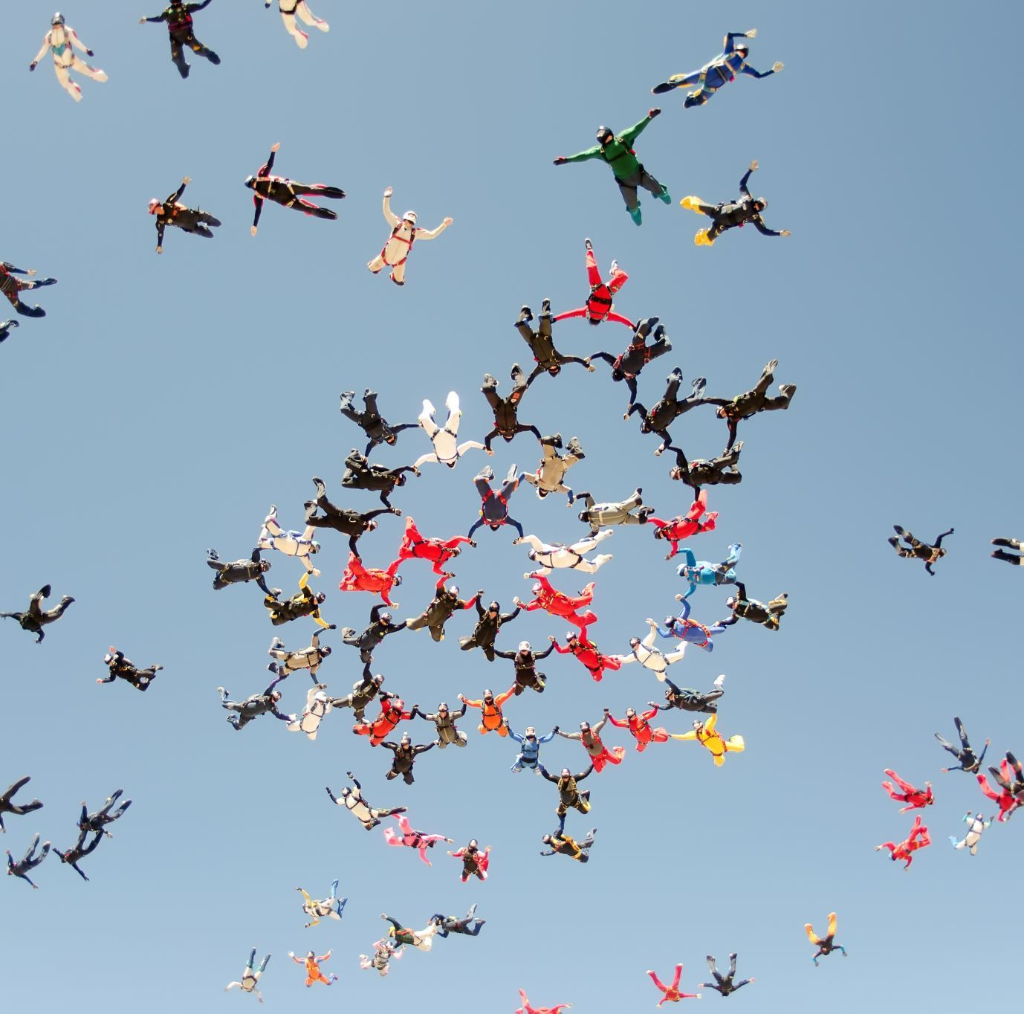
Slide 6: User Experience and Impact
Title: “Enhancing User Experience”
Content
1.Discuss the benefits of the solution for the stakeholders
2.Highlight potential impact on user organization website
Higher conversion rates
Enhanced customer loyalty
Competitive advantage

